Slide 1
THIS IS TO CERTIFY THAT THE FOLLOWING COMPLETED THEIR FIRST SEMESTER PROJECT
FASHANU TIMILEYIN SOLOMON
LAWAL KAMALDEEN AYOMIDE
APTECH BATCH:440

Slide 2
ACKNOWLEDGMENTS
All thanks to God almighty for the gift of knowledge and insight.
our appreciation goes to all the faculty/instructor, Mr. Omoefe Joseph for his support and guidance towards the successful completion of this project.
To all the staff and management of Aptech Computer Education, Surulere Center Lagos, Nigeria, thank you all for your support and assistance.
WE WOULD LIKE TO APPRECIATE APTECH COMPUTER EDUCATION FOR THE OPPORTUNITY OF SHOWCASE OUR NEWLY ACQUIRED SKILL IN THIS PROJECT.
Notes:
2

Slide 3
TECHNOLOGIES USED
HTML
CSS FOR DESIGN
BOOSTSTRAP FOR GRID SYSTEM
JQUERY FOR JAVA SCRIPT
NOTE: THIS PROJECT REQUIRES A SUFFICIENT NETWORK CONNECTION DUE TO PLUGINS USED.
Notes:
3

Slide 4
Project Requirement
Design a website for tourism locations
This project consists of a home page, destinations, about page, contact & bookings, map(geo-location).
Notes:
4

Slide 5
Website Functionality Chart
About:
Home Page
Holiday Locations
About
Bookings & Contact
Notes:
5

Slide 6
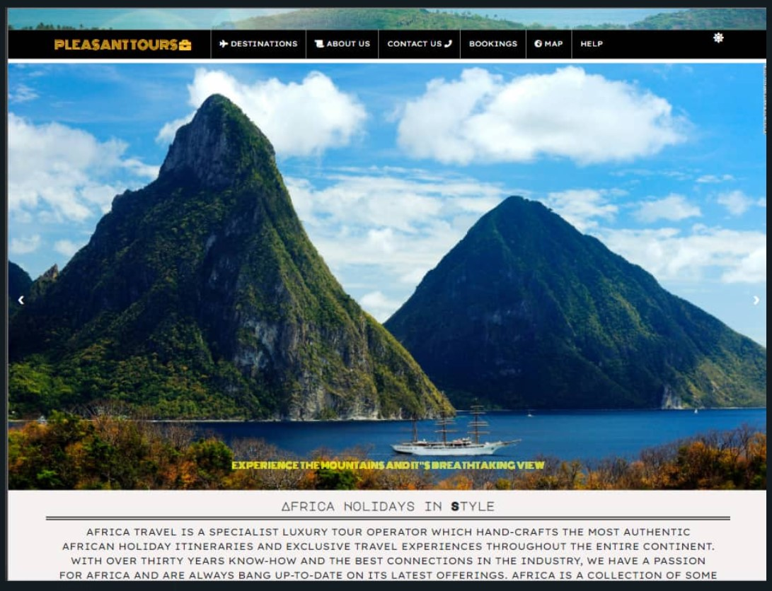
Home Page
Notes:
6

Slide 7
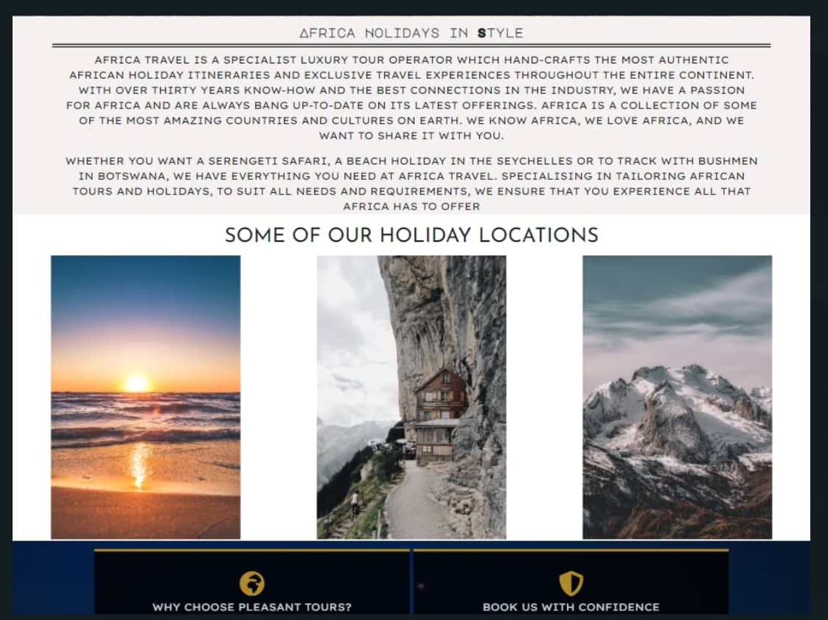
Travel Locations
Notes:
7

Slide 8
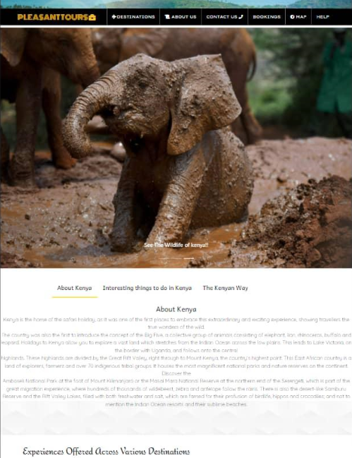
ABOUT US

Slide 9
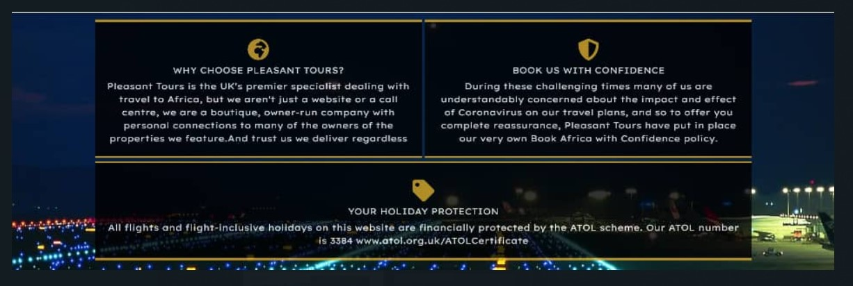
Bookings
Notes:
9

Slide 10
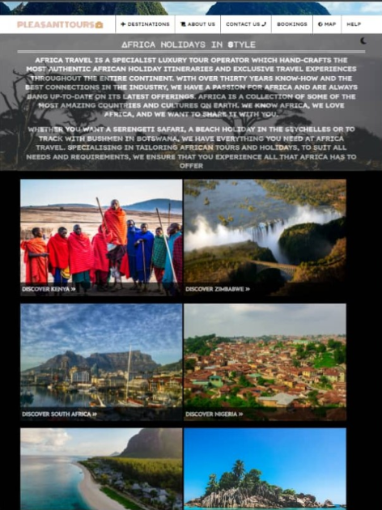
TOUR PRODUCT
PAGE
Notes:
10

Slide 11
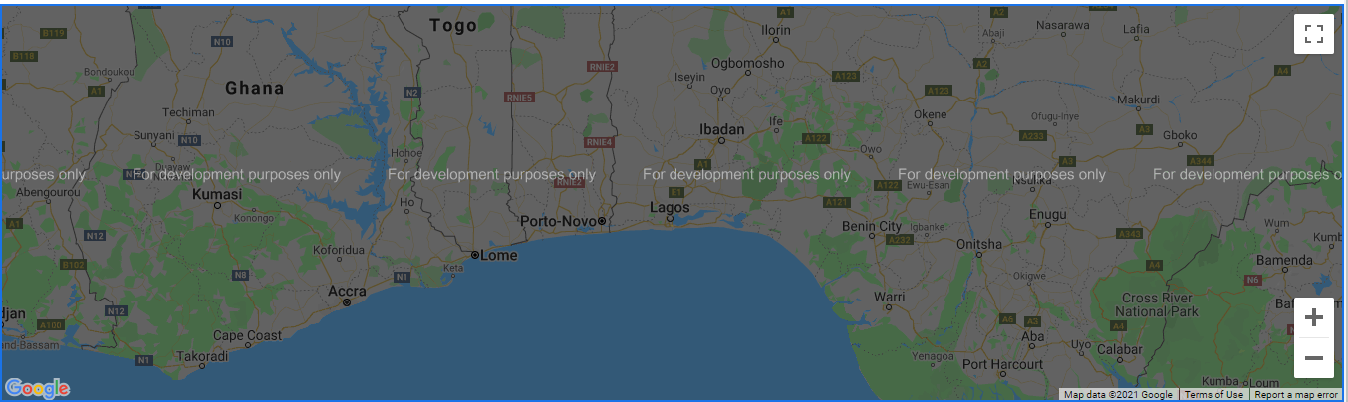
Google Geolocation Map
Notes:
11

Slide 12
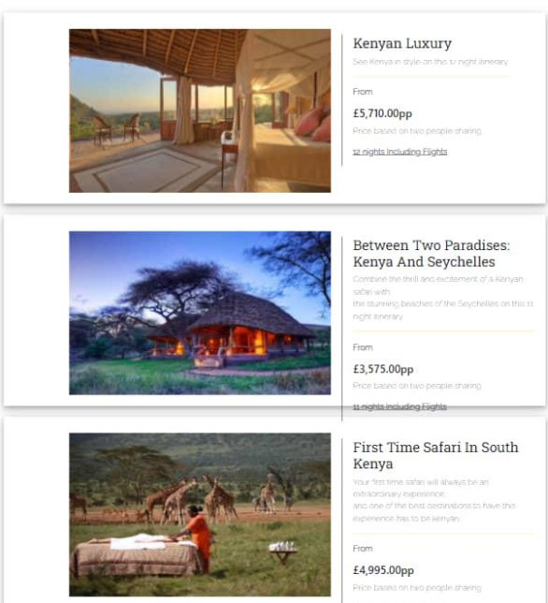
FLEXIBLE PRICING PLANS

Slide 13
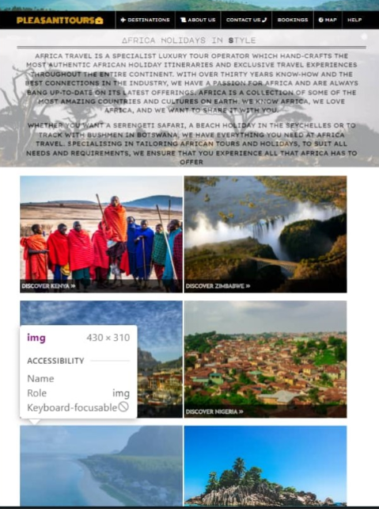
RESPONSIVE WEB PAGES

Slide 14
DEVELOPERS GUIDE
THIS Project Is designed To Engage Tour Lovers with Great Tourist site As Well as Insight About Different tourist centers. If Developers Want to Change.
Any Content on The Website, The Developer Can Access The Index page and other HTML within the website.
The source code has been commented on in details in order for any developer going through the code to easily understand and modify
This Project Was created using HTML5, CSS3 , JAVASCRIPT JQUERRY , BOOTSRAP and Geolocation .Visual Studio Code Was Used As the
HTML Text Editor and it has been tested across all leading browsers and various screen size

Slide 15
USERS GUIDE
Login
TABLE OF CONTENTS
Destinations
About Us
Contact Us
Bookings
Map
Help

